Slide 1
Virtual Job Fair v4.0 Team Members: Erick Arenas Artiom Tiurim Mentor: Juan Caraballo
CIS 4911 Senior Project
School of Computing and Information Sciences
Florida International University
December 11, 2014

Slide 2
Problems and Limitations
Problem Definition
Recruiters are constantly seeking to increase the number of qualified candidates reached by their job postings.
FIU SCIS students would greatly benefit from a system which immediately notifies them of relevant jobs.
Current System problems / limitations
Students don’t benefit from external job opportunities.
Employer can’t search specific student.
Job search is lacking features.
Rudimentary administrative interface and notification system.

Slide 3
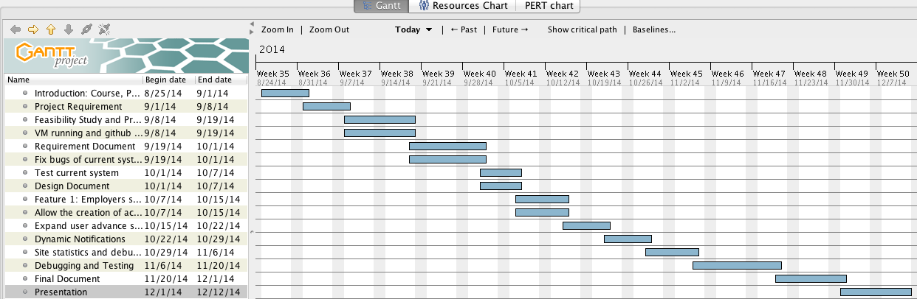
Project Management

Slide 4
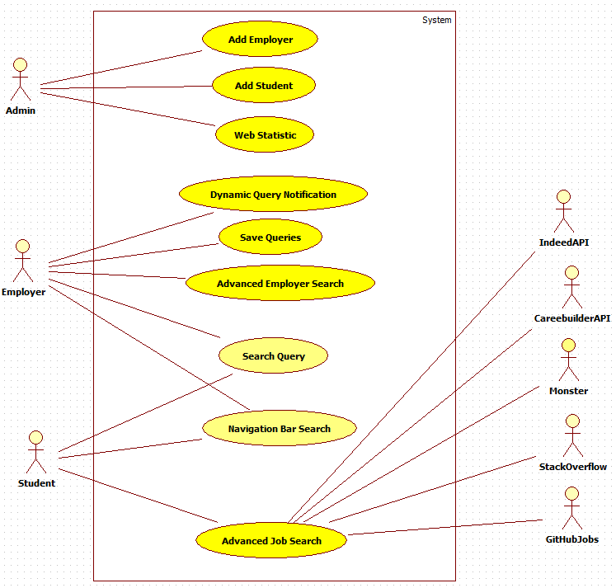
Use Case Diagram

Slide 5
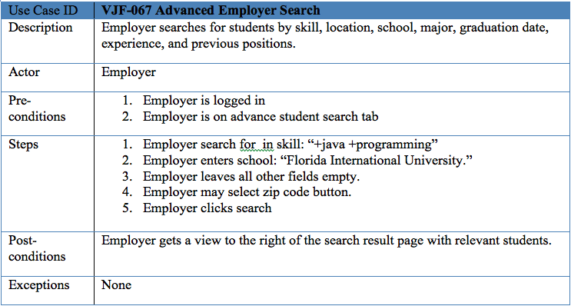
Employer Adv. Search Use Case

Slide 6
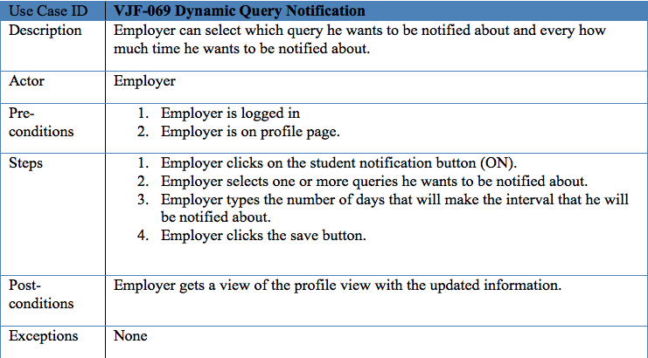
Dynamic Query Notification Use Case.

Slide 7
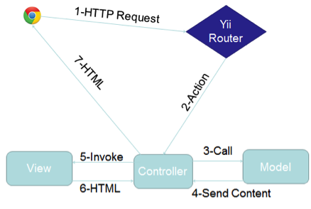
Architecture

Slide 8
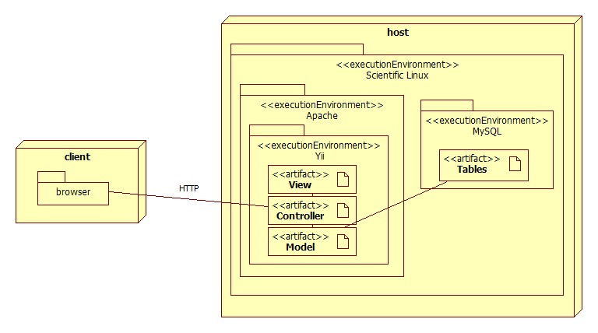
System Deployment

Slide 9
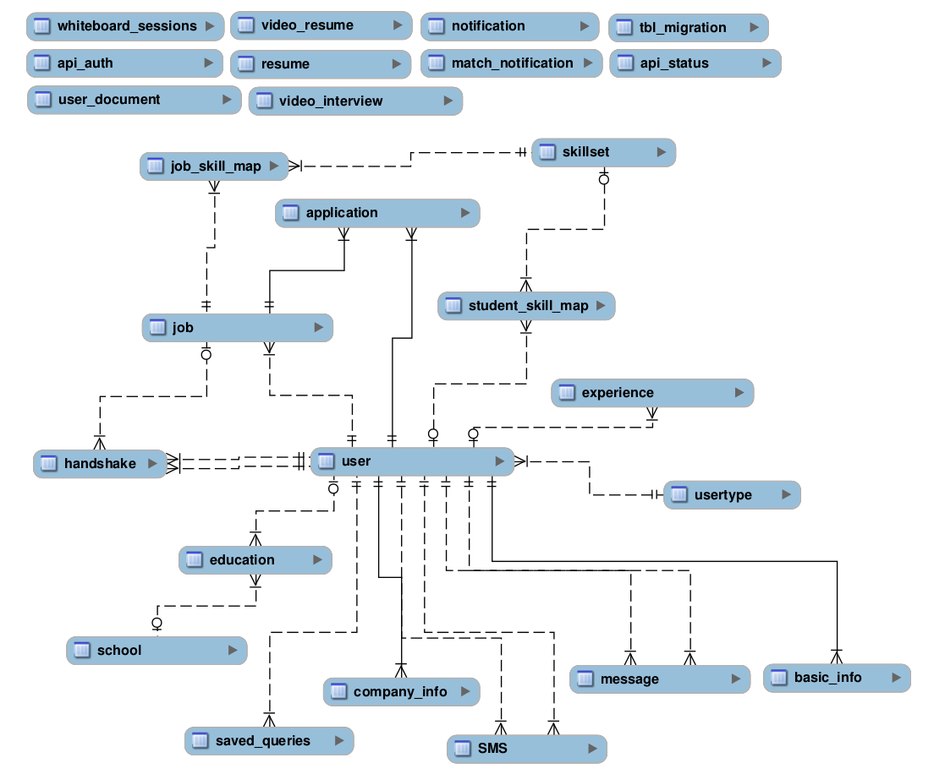
Database Design

Slide 10
Security/Privacy
User password will be hashed in the database.
Administrator will be able to disable users and delete jobs
Yii access control rules
Cross-site Scripting Prevention
Secure registration process

Slide 11
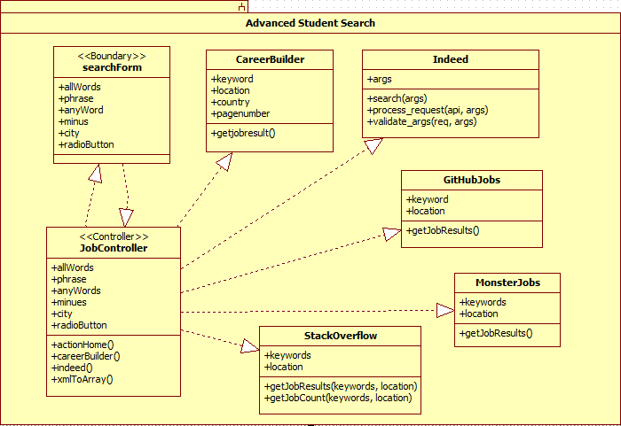
Minimal Class Diagram

Slide 12
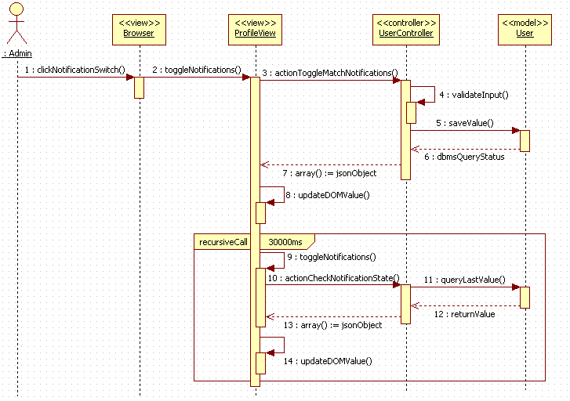
Sequence Diagram

Slide 13
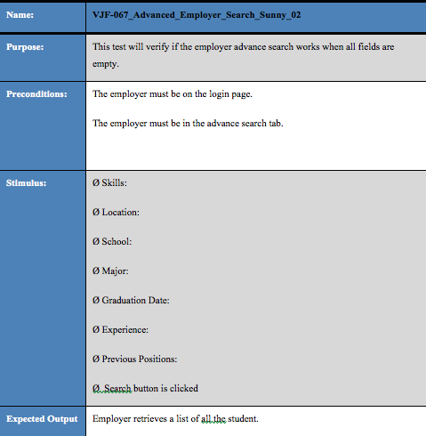
Adv. Search Sunny Test Case

Slide 14
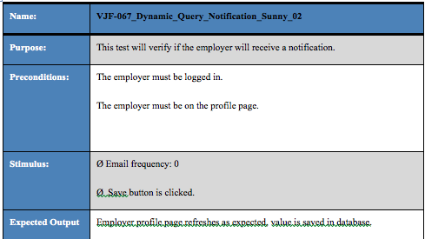
Notification System Sunny Test case

